Slide 1
Comparing Methods For Analyzing Single-Cell RNA sequencing Data
Yitong Wang (Client Liaison)
Ji-Eun Park (Project Manager)
Supervisor/Client : Dr. Davide Risso

Slide 2
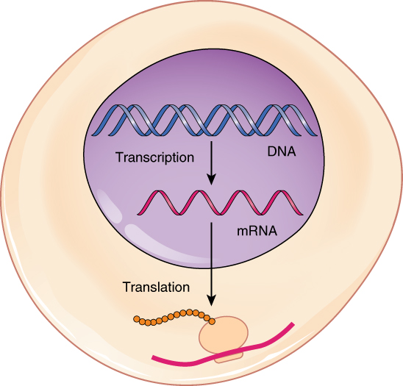
What is RNA?
Cell
Nucleus
Unlike DNA, RNA differs in each cell
Protein
Ribosome
Notes:
Inside the nucleus, DNA clones its information to generate RNA ⇒ Transcription
Outside the nucleus, RNA provides the cloned information of DNA to Ribosome where they create Protein ⇒ Translation
Unlike DNA, DNA is same in every cell. RNA is different in each cell. Now we can visualize it as it were in different groups

Slide 3
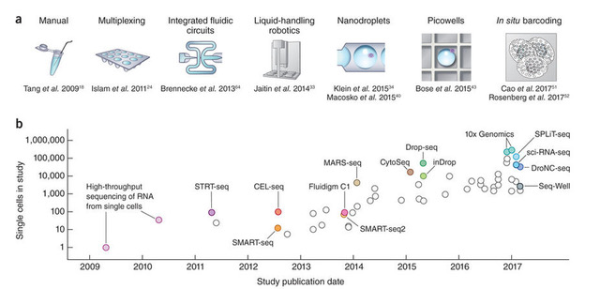
Single Cell RNA-seq Technology
Notes:
Recent type of data:
Early study, they can only measure one single cell (2009)---- one million cells 2017
Bulk RNA Seq: measure RNA in a bunch of cells (earlier earlier)
Single cell RNA: nowadays new technology could measure RNA in one cell
The size of dataset is going larger and larger, and better quality
Sequencing (technology) = measuring RNA

Slide 4

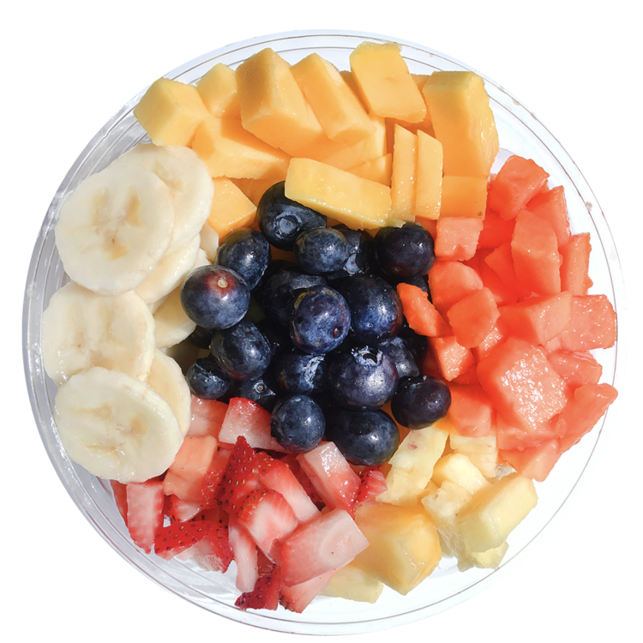
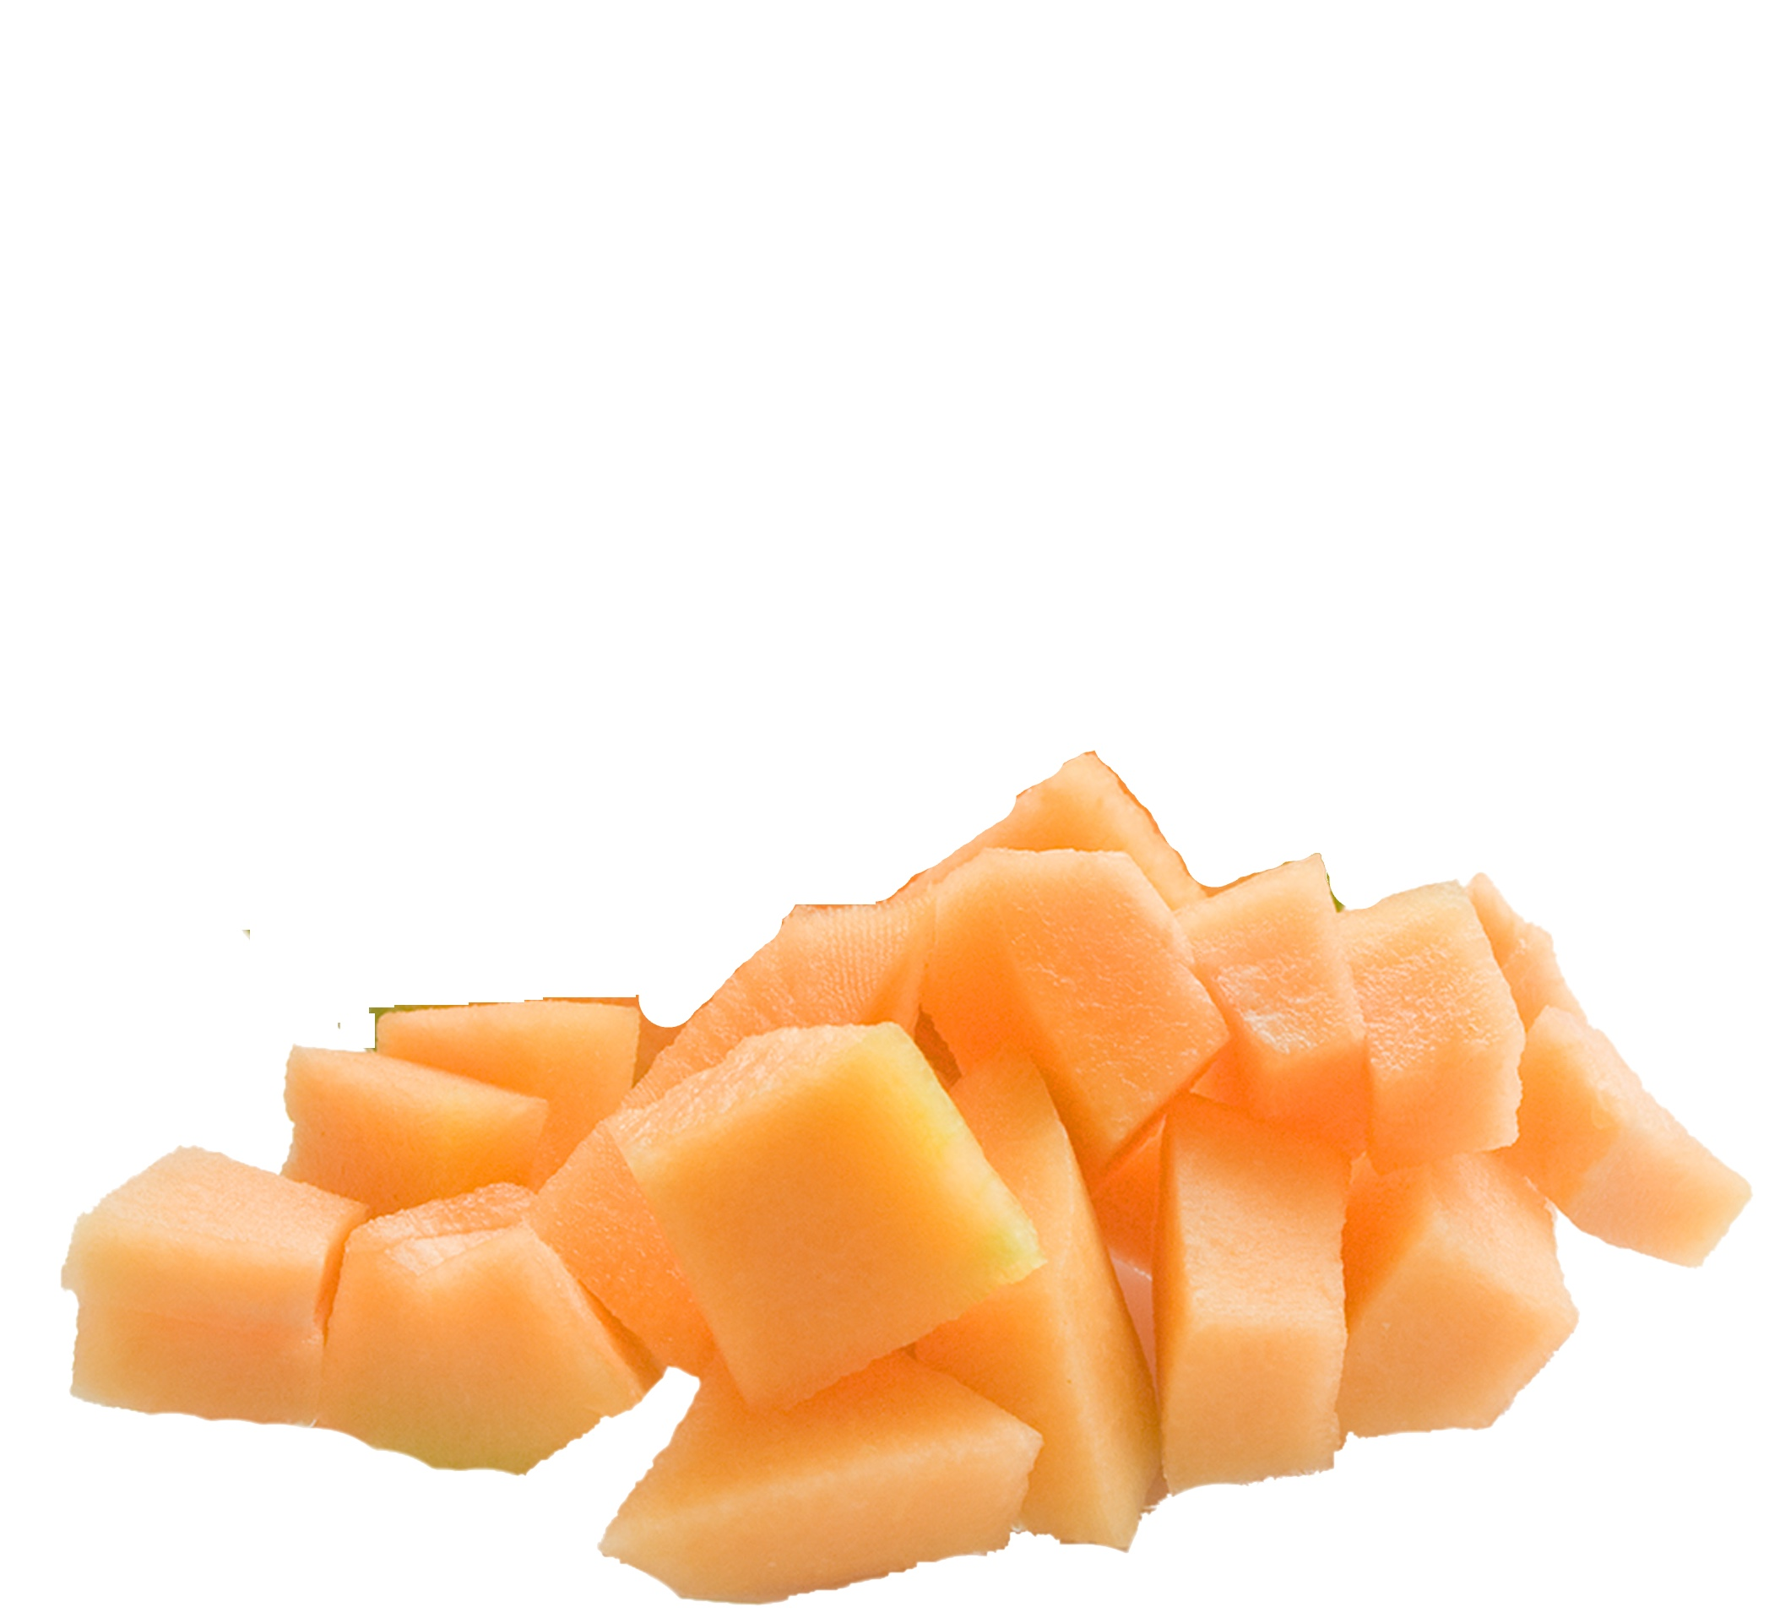
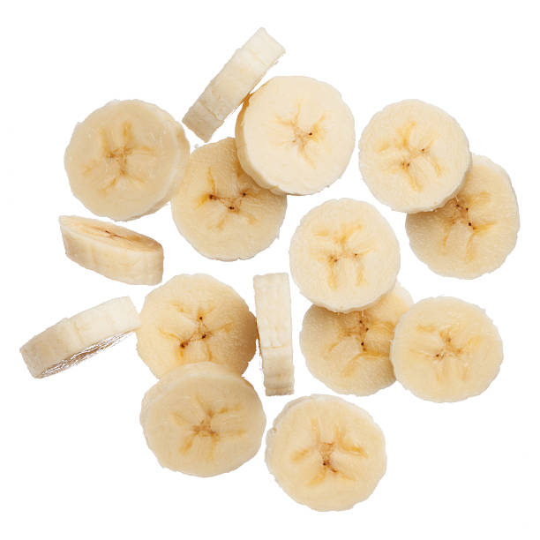
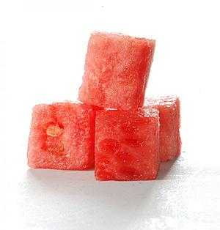
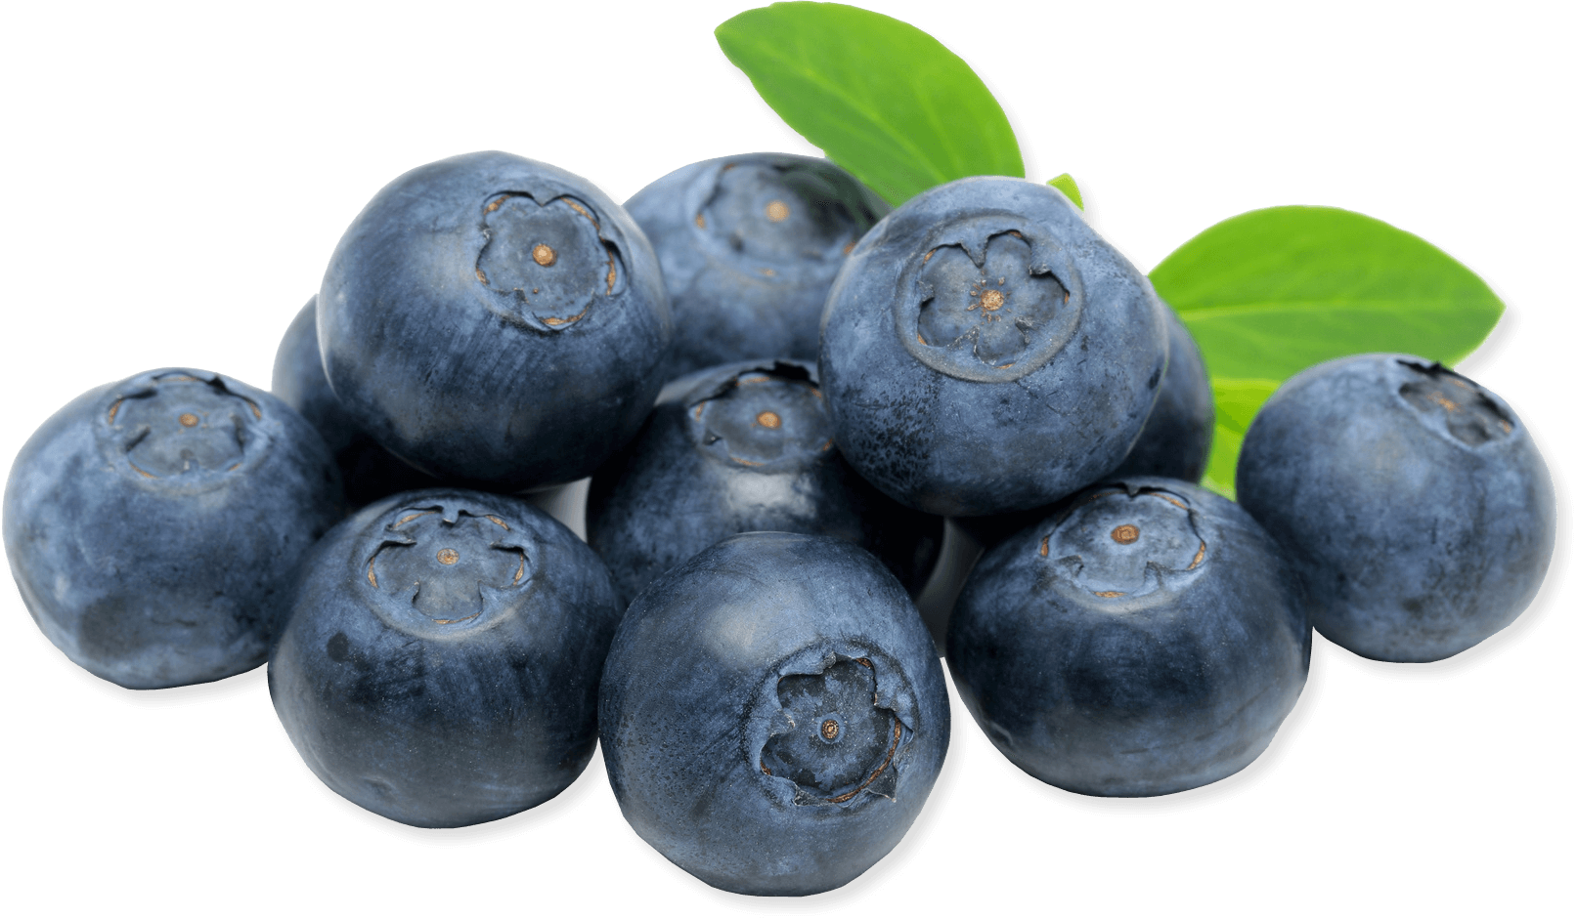
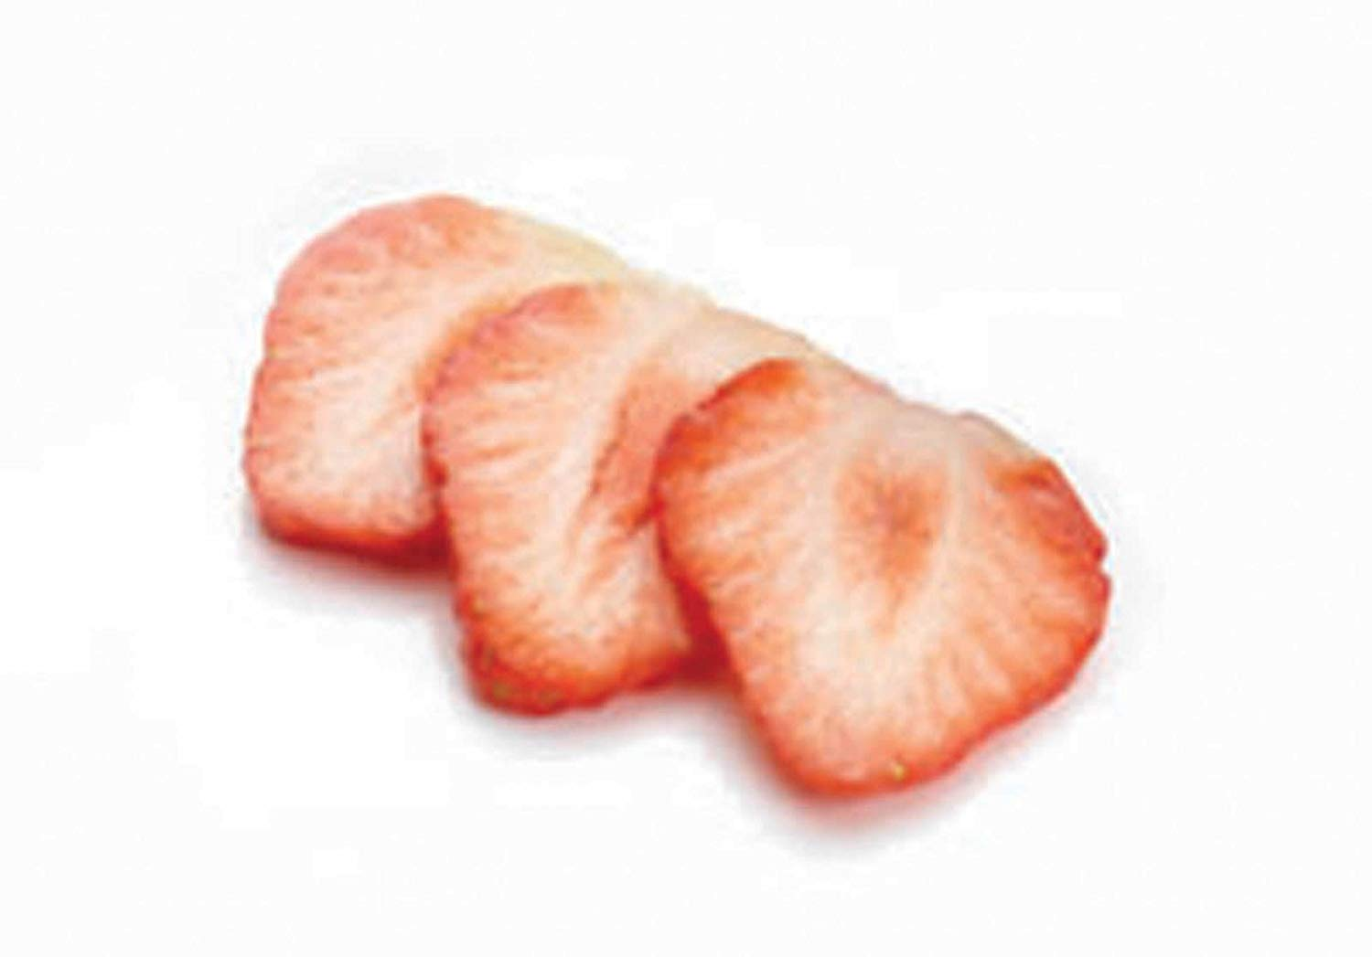
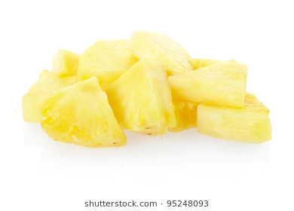
Why do we want to cluster them?
Why in single cell level?
Bulk RNA-seq
Single Cell RNA-seq
Noisy & Large
Notes:
single-cell RNA-seq (noisy, large) : Measures the distribution of expression levels for each gene across a population of cells
why do we wanna cluster? : we still do not know a lot of cell types. By clustering cells into different groups, we could predict unknown cells’ type based on the known cell type in same group or even discover new cell types.
Why in single cell level? :
Each fruit -- cell type
Each banana piece -- cell
If we only have smoothie, we can only guess there might be a bit of strawberry, a bit of banana and so on, but we are only guessing
But if we can see what fruits we have, we can actually distinguish which fruits we are actually tasting.
Imagine you never saw a fruit in your life. But by looking at the shape, color, you can cluster it into each fruits.
Before, we can only measure smoothie = an average of cells
GOAL: Measure each individual fruit = measure each individual cell
column--gene
Single cell RNA: nowadays new technology could measure RNA in one cell
Bulk RNA Seq: measure RNA in a bunch of cells
Sequencing (technology) = measuring RNA

Slide 5
Issue & Goal of the project:
Issue: True Number of Clusters & Best Clustering Methods are unknown
(scRNA-seq) technologies have rapidly developed. Many methods have been tested, developed, and validated using
simulated datasets, current simulations are often poorly documented, their similarity to real data is not demonstrated,
or reproducible code is not available.
Goal: Compare different clustering methods using simulation
Notes:
Issue: The best clustering method is also unknown

Slide 6
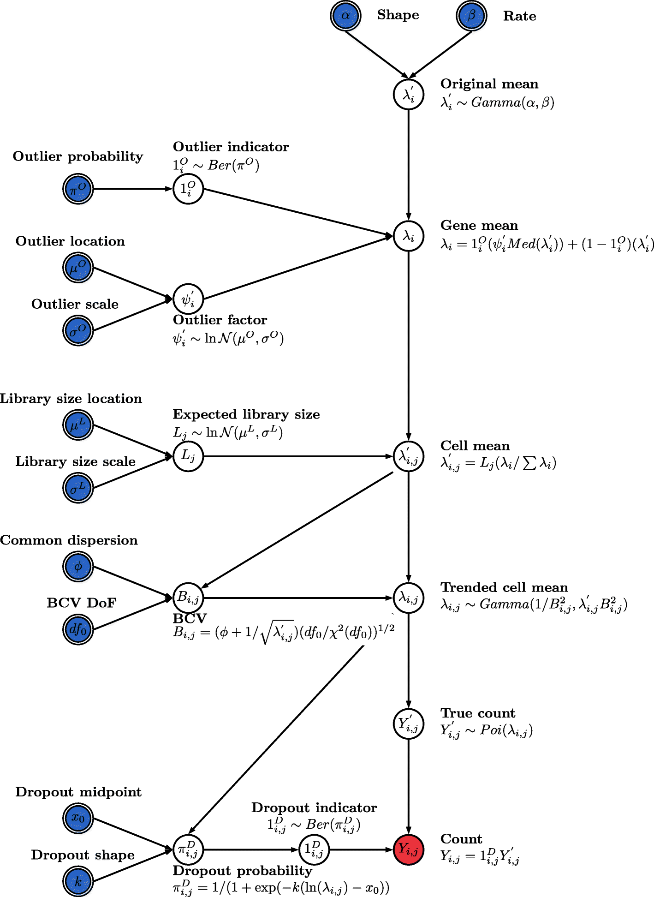
Simulation - ‘Splatter’ package
Gamma-Poisson distribution is used to generate a gene-by-cell matrix of counts. Mean expression levels for each gene are simulated from a gamma distribution and the Biological Coefficient of Variation is used to enforce a mean-variance trend before counts are simulated from a Poisson distribution.
Notes:
Splat also allows you to simulate expression outlier genes (genes with mean expression outside the gamma distribution) and dropout (random knock out of counts based on mean expression). Each cell is given an expected library size (simulated from a log-normal distribution) that makes it easier to match to a given dataset.
https://genomebiology.biomedcentral.com/articles/10.1186/s13059-017-1305-0

Slide 7
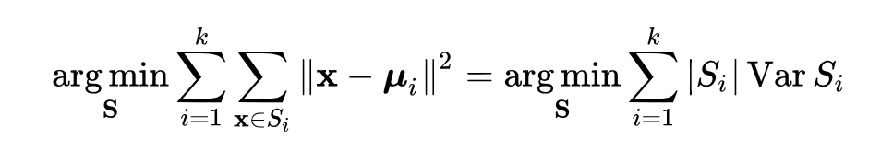
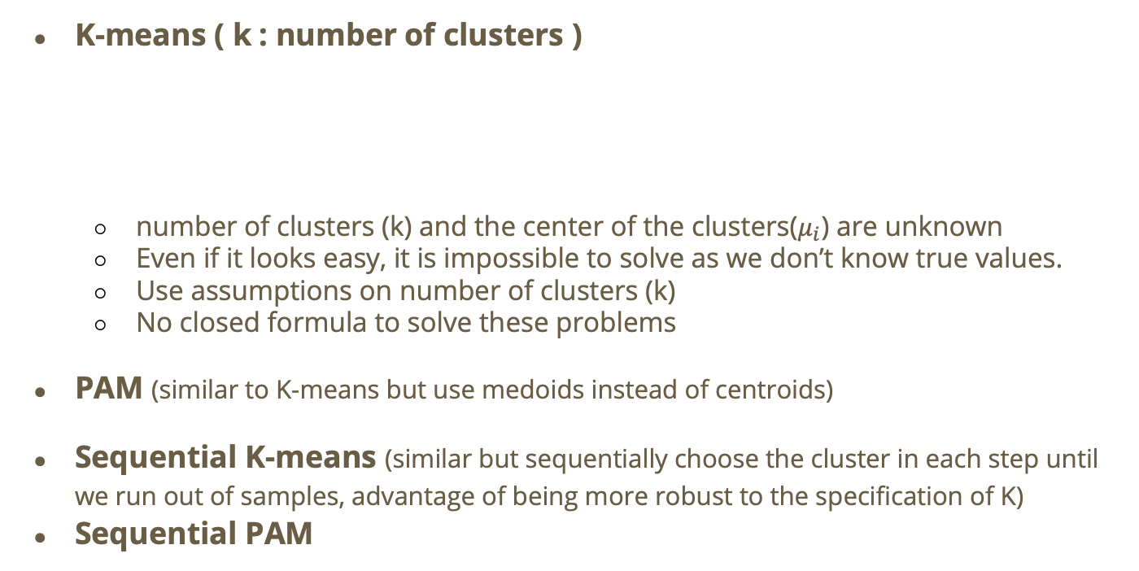
Clustering Methods
K-means ( k : number of clusters )
number of clusters (k) and the center of the clusters($μ_{i}$) are unknown
Even if it looks easy, it is impossible to solve as we don’t know true values.
Use assumptions on number of clusters (k)
No closed formula to solve these problems
PAM (similar to K-means but use medoids instead of centroids)
Sequential K-means (similar but sequentially choose the cluster in each step until we run out of samples, advantage of being more robust to the specification of K)
Sequential PAM
where μ_{i} is the mean of points in S_{i}
Notes:
K-means: minimize the sum of ^2 of difference between observations and mean of points

Slide 8
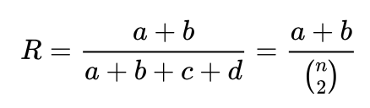
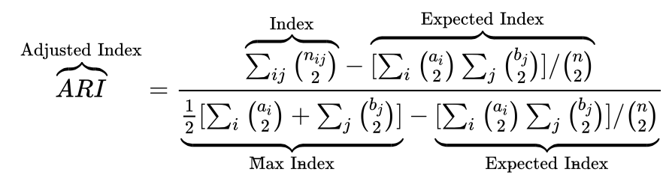
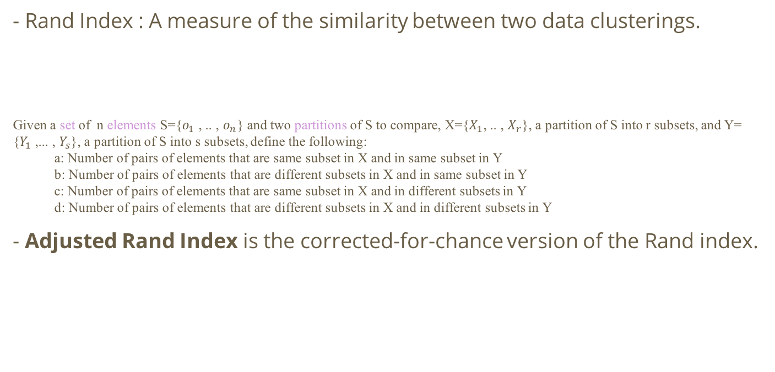
Evaluation Criteria : Adjusted rand index
- Rand Index : A measure of the similarity between two data clusterings.
Given a set of n elements S={$o_{1}$ , .. , $o_{n}$} and two partitions of S to compare, X={$X_{1}$, .. , $X_{r}$}, a partition of S into r subsets, and Y= {$Y_{1}$ ,... , $Y_{s}$}, a partition of S into s subsets, define the following:
a: Number of pairs of elements that are same subset in X and in same subset in Y
b: Number of pairs of elements that are different subsets in X and in same subset in Y
c: Number of pairs of elements that are same subset in X and in different subsets in Y
d: Number of pairs of elements that are different subsets in X and in different subsets in Y
- Adjusted Rand Index is the corrected-for-chance version of the Rand index.
Notes:
What is Rand Index?
RI Problem: it can be large by change (random data may have high RI if you are luck ex:0.5, 0.6)
ARI: adjust index so it considers the possibility of getting a good index just by chance
Adjust for all random ways you can shuffle the data
Complete random--ARI=0

Slide 9
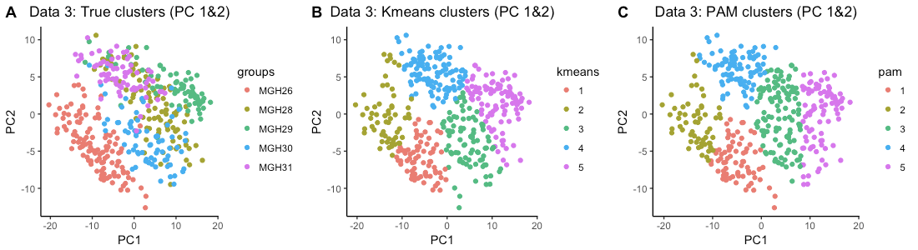
Preprocessing : Principal Component Analysis (PCA)
RNA-seq data is high dimensional - about 20,000 genes (variables)
It has been shown that the dimensionality reduction step improves clustering
Here we use Principal component analysis as a dimensionality reduction.
Notes:
20000 genes we projets to 2 PC
PCA is a linear method. Each pc is a linear combination of the genes(variables).
PCA will find the 1st PC linear combination of the genes that explains the most variance of the data. (PC=1)
PCA will find the 2nd orthogonal linear combination of the genes to the 1st PC, that explains the second most variance of the data. (PC=1)
Ex: Fairly well separated

Slide 10
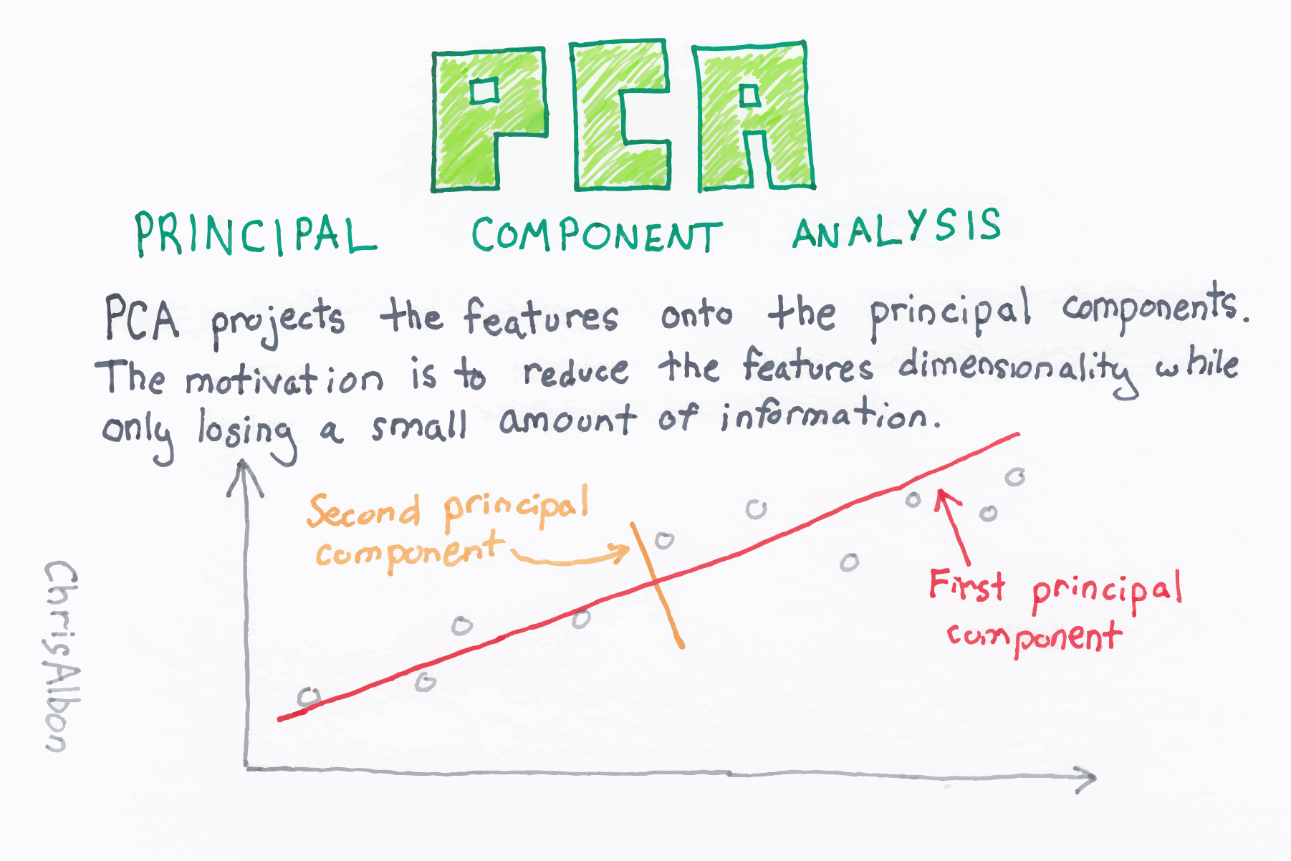
Principal Component Analysis (PCA) - detail
Notes:
PCA is a linear method. Each pc is a linear combination of the genes(variables).
PCA will find the 1st PC linear combination of the genes that explains the most variance of the data. (PC=1)
PCA will find the 2nd orthogonal linear combination of the genes to the 1st PC, that explains the second most variance of the data. (PC=1)

Slide 11
Understanding K-means
Fruit Bowl = Set of Cells
True Clusters : 6
Blueberry
Banana
Cantaloupe
Watermelon
Strawberry
Pineapple
In real life, the true number of clusters
& what each clusters represent are unknown

Slide 12
Iteration 1
6 centroids
selected randomly
Each cells are assigned to the nearest centroid

Slide 13
Iteration 1
Centroids are computed
within each cluster
Centroids change :
Black → White
Notes:
Centroids are computed by the means

Slide 14
Iteration 2
Centroids are recomputed within each cluster
Centroids change :
Black → White → Blue

Slide 15
Final Iteration
Eventually, centroids & clusters converges and stop changing
→ Final cluster

Slide 16
Sequential Methods
Sequential method relies on a base clustering algorithm, like subsampling, which is iteratively re-applied after each removal of a cluster.
For each clustering iteration, the sequential algorithm requires a method for specifying which is the “best” cluster so that it can be removed and then move on to the next iteration.
Cluster which varies the least in its membership as the parameter K for the number of clusters is increased, as measured by the maximal percentage overlap of clusters from clusterings from K and K + 1

Slide 17
Sequential K-means : Iteration 1
Run k-means with k=6
Notes:
Centroids are computed by the means

Slide 18
Iteration 1
Run k-means with k=7
Notes:
Centroids are computed by the means

Slide 19
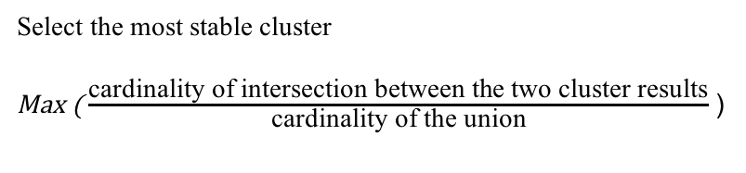
Iteration 1
Notes:
Compare two results with 2 different K

Slide 20
Iteration 2
Remove most stable cluster and start over iteration with k=5 & 6
Notes:
Compare two results with 2 d
Ex: most stable cluster is banana, we remove it , and we do cluster on the rest of fruits, and remove the most stable cluster.

Slide 21
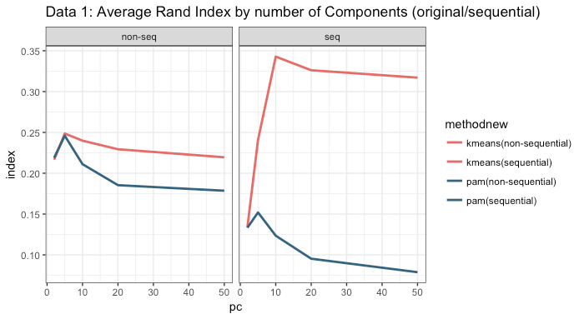
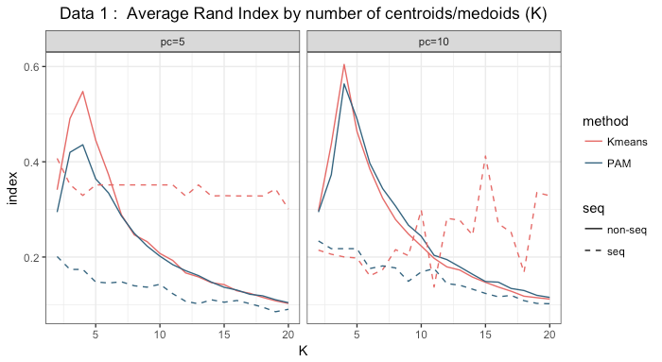
Results - Data 1
K-means > PAM
Sequential : stable
When K is selected correctly, non-seq is better
Notes:
Try to find best PC in each methods
We choose pc=5,10, because it has highest ARI
If you knew cluster=5, then using non-seq is better, but in reality, you do not know K, so it is better to use seq since it produces more stable ARI

Slide 22
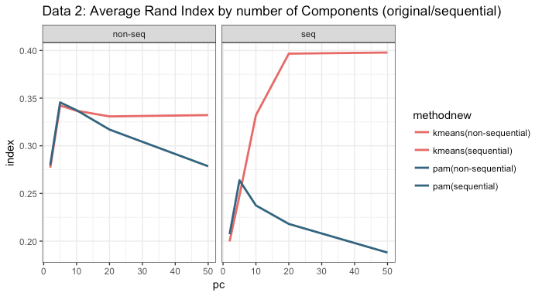
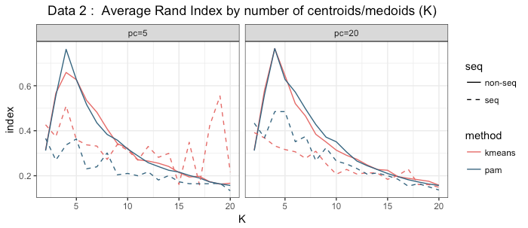
Results – Data 2
K-means is more consistently better
With the best value of PC and K, PAM is equally or even slightly better than K-means

Slide 23
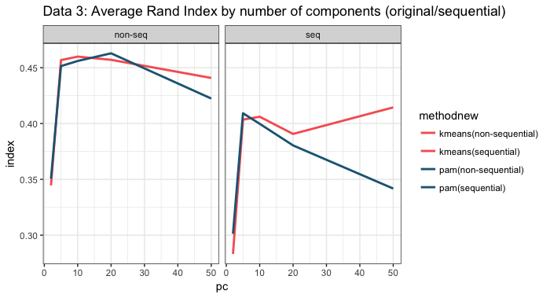
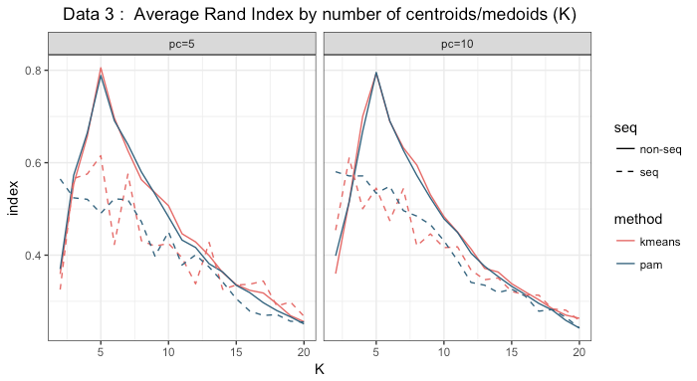
Results – Data 3 (No simulation)
There is no significant difference between K-Means and PAM
Sequential looks noisy
Notes:
Although in real data, we don’t usually know the real clusters, in this dataset we already know that there are five different cell types (clusters)
Seq looks noise in simulation 2 and real data.
We are still figuring which methods works better.

Slide 24
Result – Comparison
K-means and PAM show similar results
Does not perfectly match with the true clusters.
Notes:
We could visualize the data using PCA
It shows PAM and K-means are similar, but it does not perfectly match the real clusters result.
No methods is perfect in our data set, but there are many more proposed cluster methods that we could try.

Slide 25
Conclusions
It is difficult to simulate realistic data.
For simulations, K-Means works better.
For the real data, neither K-Means nor PAM dominates as the “better” algorithm.
Non-sequential(traditional) methods gives the highest average random Index.
Cons : Only when the number of clusters (k) is correctly assigned,
Sequential methods are robust to the choice of the number of clusters(k).
Cons : Took twice as much time compared to traditional algorithms.
No method is perfect in our datasets
Many possible proposed clustering methods can be attempted.
I.e., Subsampling, Ensemble clustering, ...
Notes:
Comparing simulations to real data results shows that it is difficult to simulate realistic data.
However, although the highest index value is lower, the index of sequential methods shows independence from the choice of number of clusters(k).
The way the model is designed, it’s designed to simulate from the mean. Specify the mean and simulate around the mean, which makes better for k-means which use the means than PAM which means median.

Slide 26
Data
a) p63-HBC-diff dataset -> simulations
b)Li, H. et al. Reference component analysis of single-cell transcriptomes elucidates cellular heterogeneity in human colorectal tumors. Nat. Genet. (2017) 55186 features 561 samples -> simulations
c) Patel, A. P. et al. Single-cell RNA-seq highlights intratumoral heterogeneity in primary glioblastoma. Science 344, 1396–1401 (2014) 5948 features 430 samples -> use real data, don't simulate

Slide 27
Q&A

Slide 28

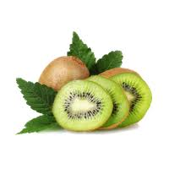
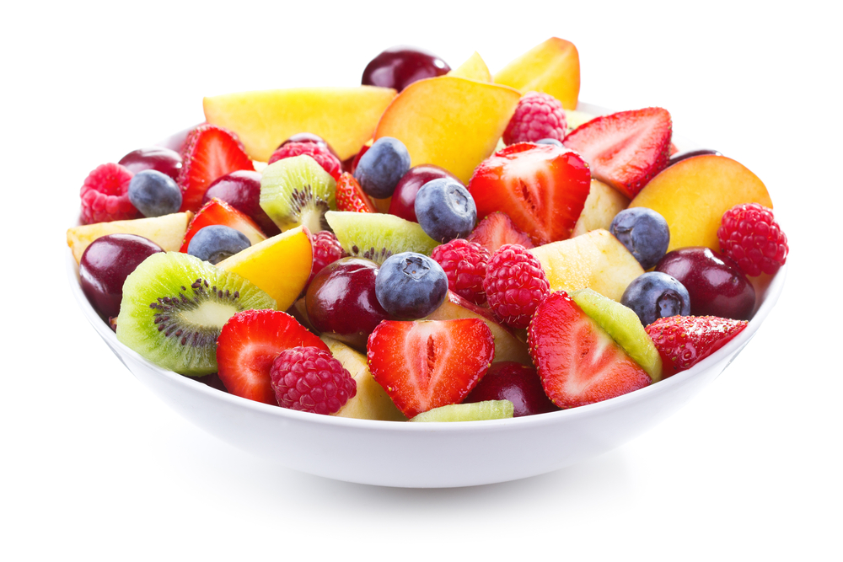

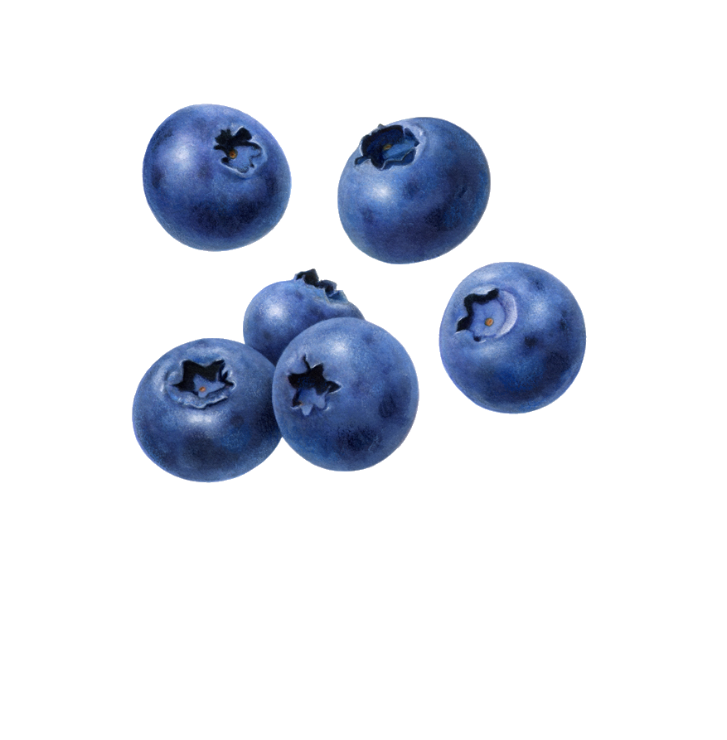

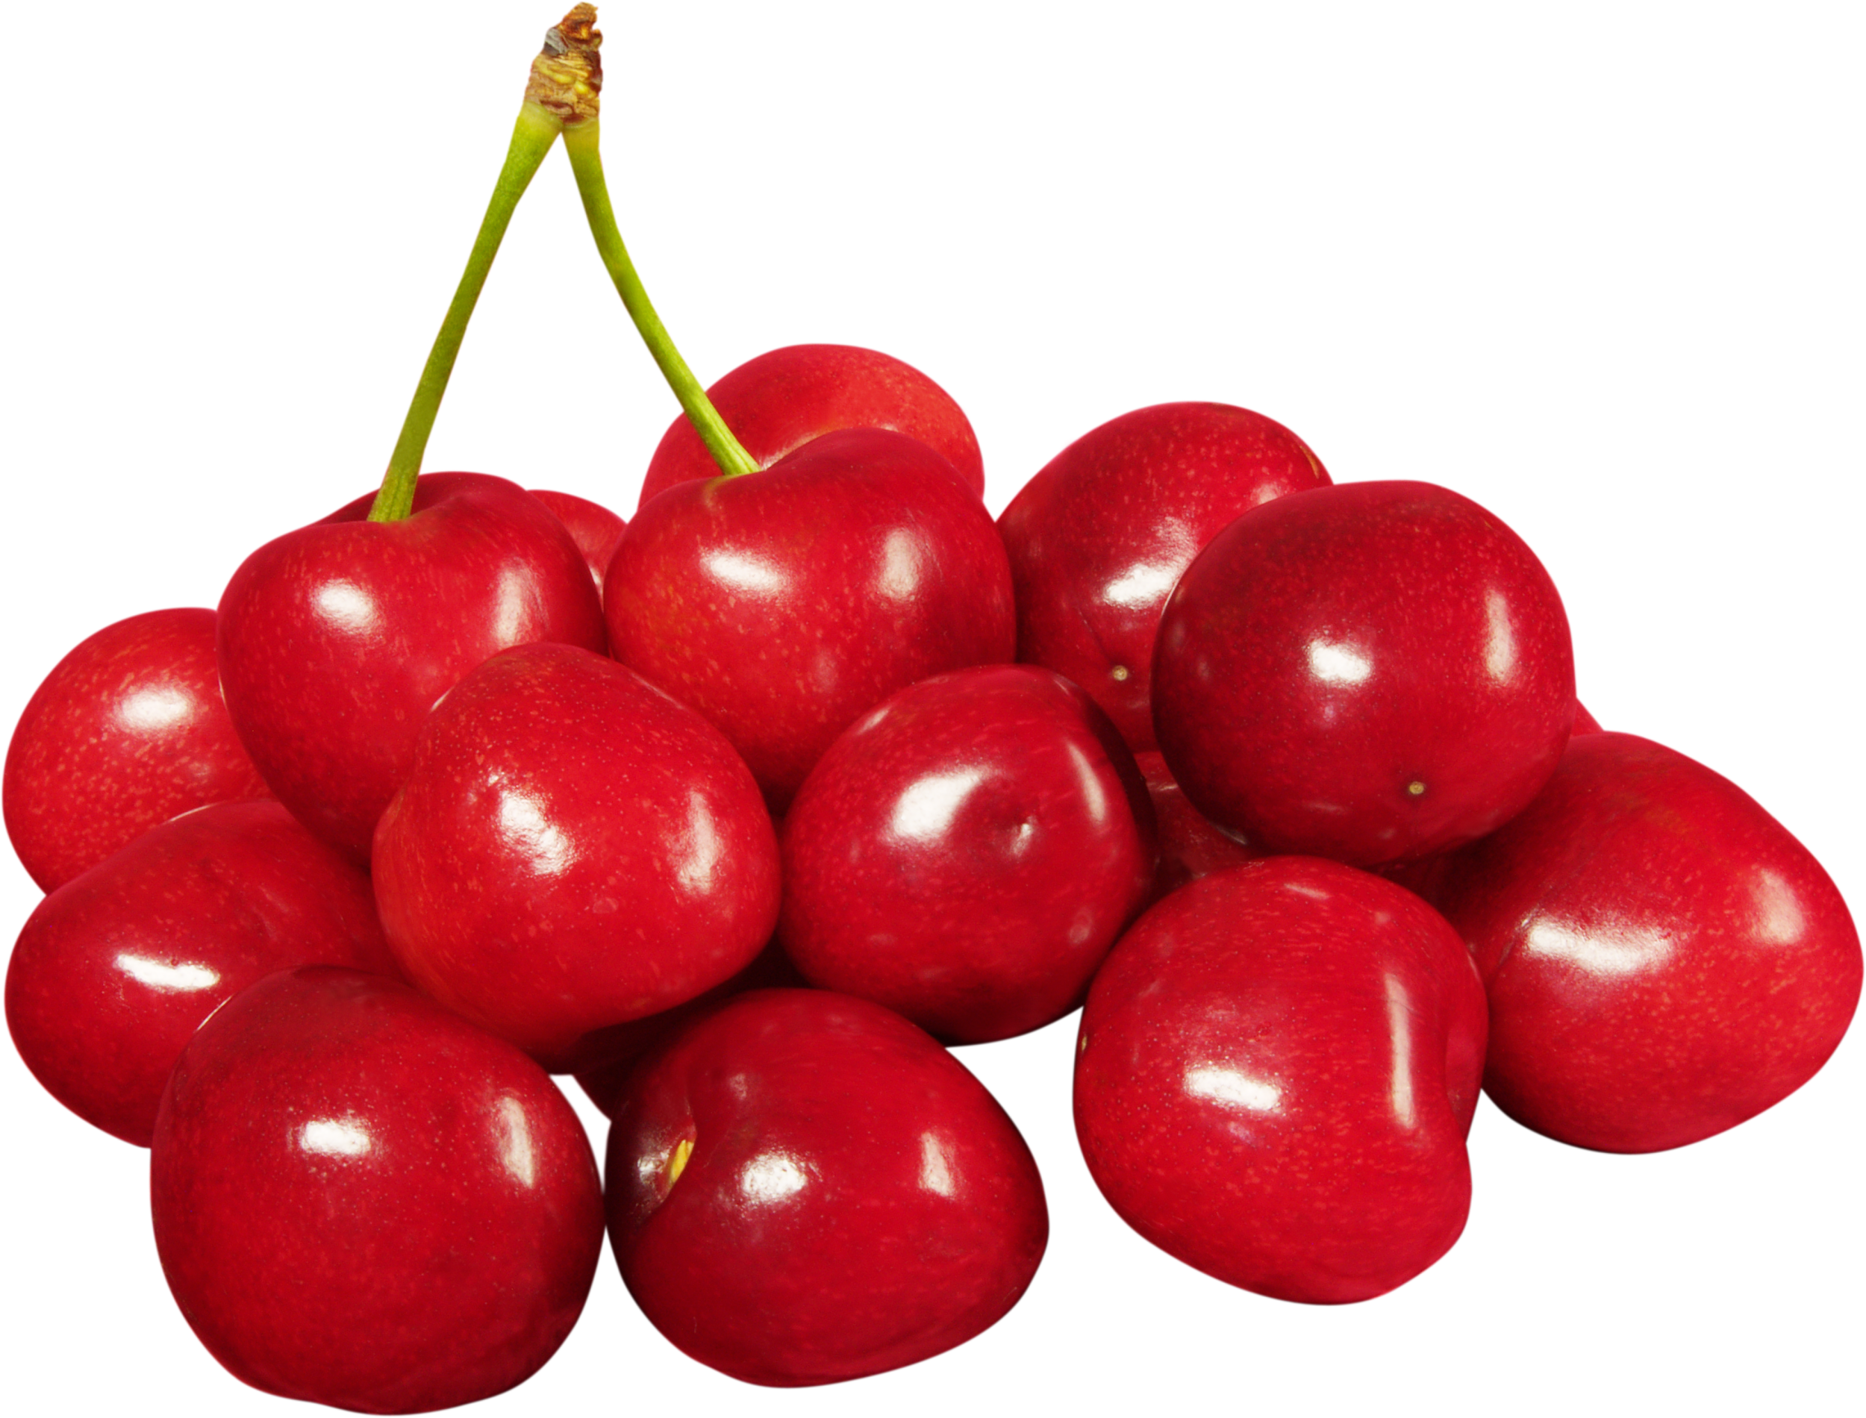
Why do we want to cluster them?
Why in single cell level?
Noisy & Large

Slide 29
Agenda
Background & Goals
Methods: PCA (P)-----clusterMany (seq=TRUE, seq=FALSE) (consider adding a formula / add a simple example)
Regular K-means
Regular PAM
Seq K-means
Seq-PAM
Issue: we do not know the true number of clusters / Goal of the project: Compare methods via simulation
Evaluation criteria: Adjusted rand index (highest --best result)
Results: plots (make these as large as possible, and few texts)
conclusions: ------------------------------------------------------------------------------ ( in the back add slides but don’t show unless asked) Datasets: simulated: PG3, Li real: Potd--real Sequential methods Simulation (vignette of splatter)

